Slide 1




GRADUATION PROJECT
Build Ninja School Offline 2D game
Presenters
Full name : Quach Van Dai
Class : Vietnamese English Information Technology 2
Course : 61
Student code: 202602919
Supervisor: Dr. Nguyen Duc Du
Hanoi, 25 June 2024
1
Notes:
111
Monday, June 24, 2024
1

Slide 2
***Outline***
I
OVERVIEW
II
USER INTERFACE DESIGN
III
CONCLUSION
2

Slide 3

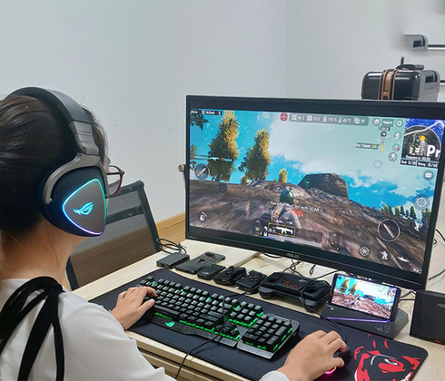
CHAPTER I. OVERVIEW
1.1 Reason for choosing the topic
In modern life, the pressures of work and study often lead people to seek out hobbies and activities to reduce stress, and gaming is one of the choices for that need.
Playing games not only helps us reduce stress and relax, but it also helps develop intelligence, critical thinking, perseverance in learning, and enhances time management skills.
3
1
Notes:
Monday, June 24, 2024
3

Slide 4
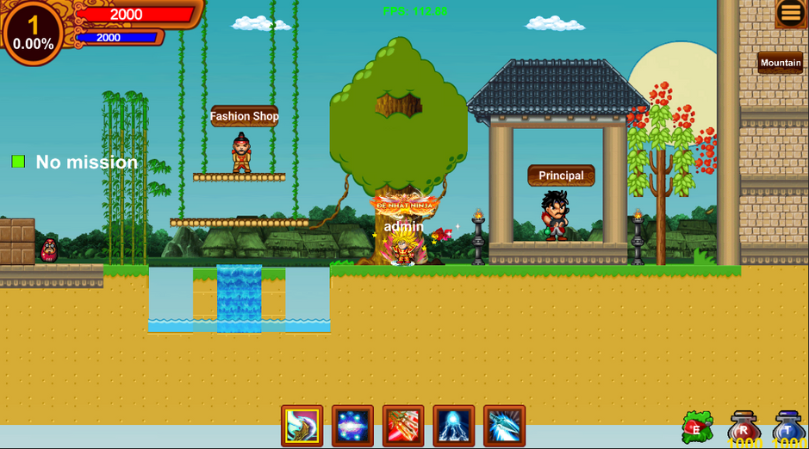
CHAPTER I. OVERVIEW
1.2 Brief introduction about the topic
Ninja school is an exciting adventure game. Players will take on the role of characters in the game. To increase their strength, players will have to diligently do tasks from the principal. To complete the mission, the player must go through difficult terrain challenges and monsters.
With an attractive visual interface and dynamic sound effects, it creates an interactive and captivating gaming environment.
4
2
Notes:
Monday, June 24, 2024
4

Slide 5


CHAPTER I. OVERVIEW
1.3 Introduction to the development environment
Engine Unity
+ Multi-platform
+ Easy to use and accessible
+ The unity user community is very large.
C# programming language technology.
+ C# is an Object Oriented Programming language
+ Developed by Microsoft's engineering team in 2000
+ C# is a simple language
+ C# is a low-keyword language
+ Easy to use and accessible
5
3
Notes:
Monday, June 24, 2024
5

Slide 6
CHAPTER II. USER INTERFACE DESIGN
2.1 Game overview
Game genre | Game Platform 2D ,role-playing, action, adventure.
Game Mode(Single or Multi) | Single player.
Level | Easy and average
Suitable players | Players over 6 years old .
6
4
Notes:
Monday, June 24, 2024
6

Slide 7
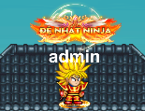
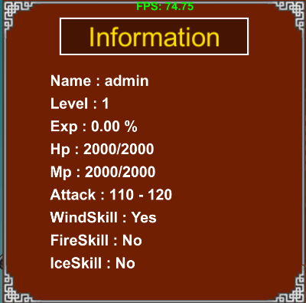
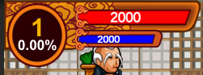
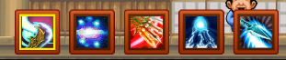
CHAPTER II. USER INTERFACE DESIGN
2.1 Game overview
7
5
Notes:
Monday, June 24, 2024
7

Slide 8
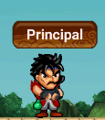
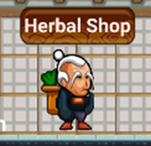
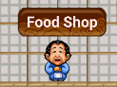
CHAPTER II. USER INTERFACE DESIGN
2.1 Game overview
NPC (Non-Player Character)
 | Assign challenges to players.
 | Sell herbal items
 | Sell food items
8
6
Notes:
Monday, June 24, 2024
8

Slide 9
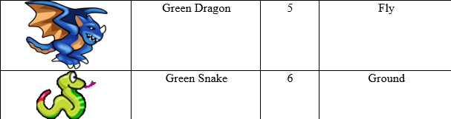



CHAPTER II. USER INTERFACE DESIGN
2.1 Game overview
Increases player's HP and MP
Increases player's HP
Increases player's MP
9
7
Notes:
Monday, June 24, 2024
9

Slide 10
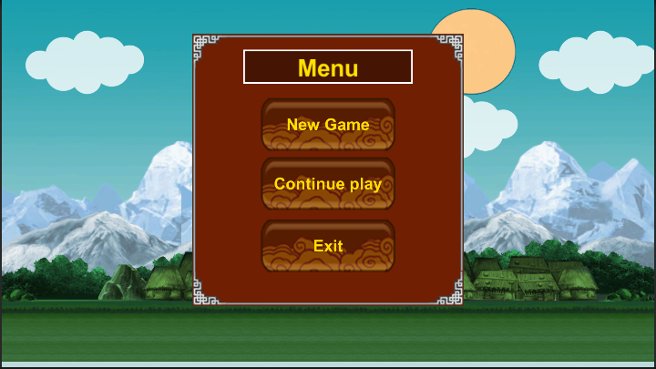
CHAPTER II. USER INTERFACE DESIGN
2.2 Interface design
The game's main screen is the starting point for the player and provides options for navigating the game.
Scene game menu
10
8
Notes:
Monday, June 24, 2024
10

Slide 11
CHAPTER II. USER INTERFACE DESIGN
2.2 Interface design
The game's first map is a vast and diverse landscape waiting for you to explore. This is the school where you will practice movement skills to get familiar with the surrounding environment
Scene school
11
9
Notes:
Monday, June 24, 2024
11

Slide 12
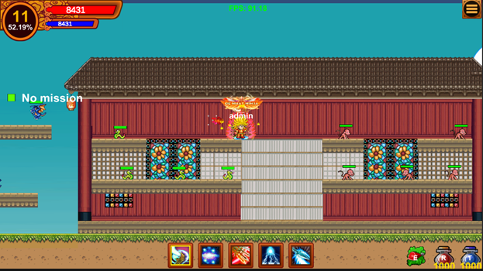
CHAPTER II. USER INTERFACE DESIGN
2.2 Interface design
+ This is a map where monsters appear.
+ Your mission is to destroy those monsters to increase your strength.
+ After destroying them, you will receive items.
Scene TempleA
12
10
Notes:
Monday, June 24, 2024
12

Slide 13
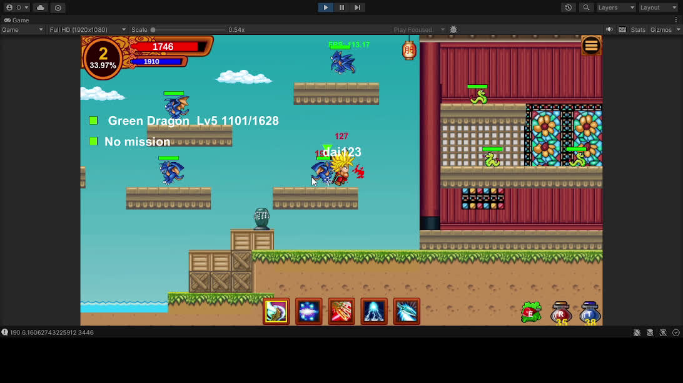
CHAPTER II. USER INTERFACE DESIGN
2.2 Interface design
12
11

Slide 14
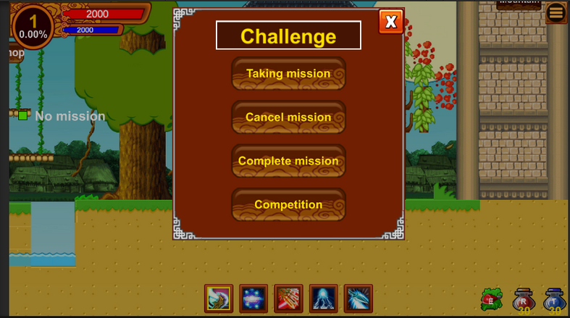
CHAPTER II. USER INTERFACE DESIGN
2.2 Interface design
Mission function
13
12
Notes:
Monday, June 24, 2024
13

Slide 15
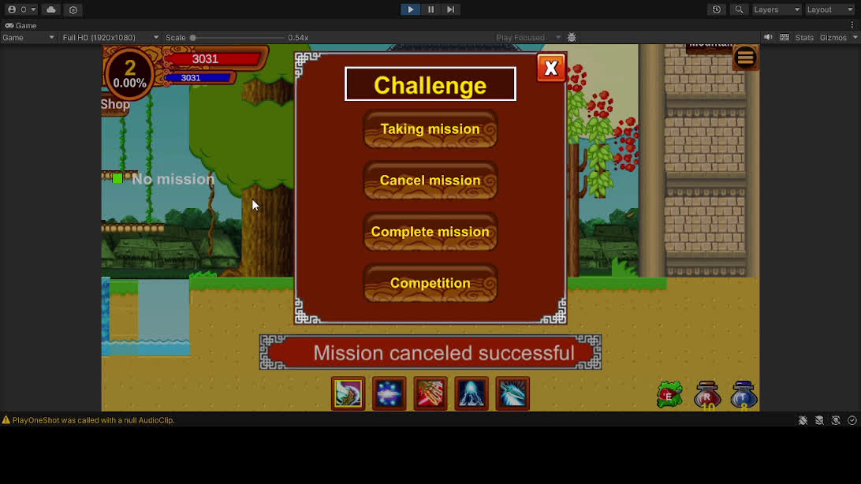
CHAPTER II. USER INTERFACE DESIGN
2.2 Interface design
13
13

Slide 16
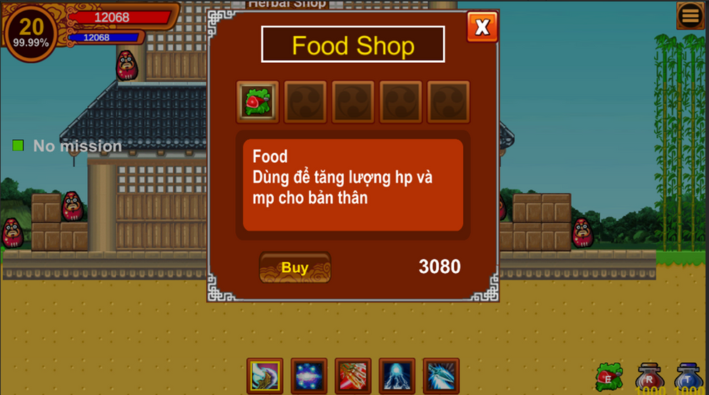
CHAPTER II. USER INTERFACE DESIGN
2.2 Interface design
Function to buy items
Buy food item
14
14
Notes:
Monday, June 24, 2024
14

Slide 17
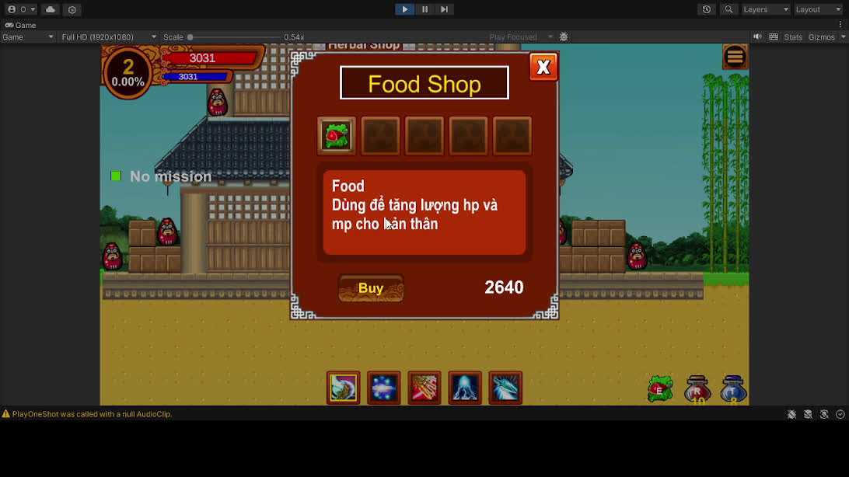
CHAPTER II. USER INTERFACE DESIGN
2.2 Interface design
Function to buy items
14
15

Slide 18
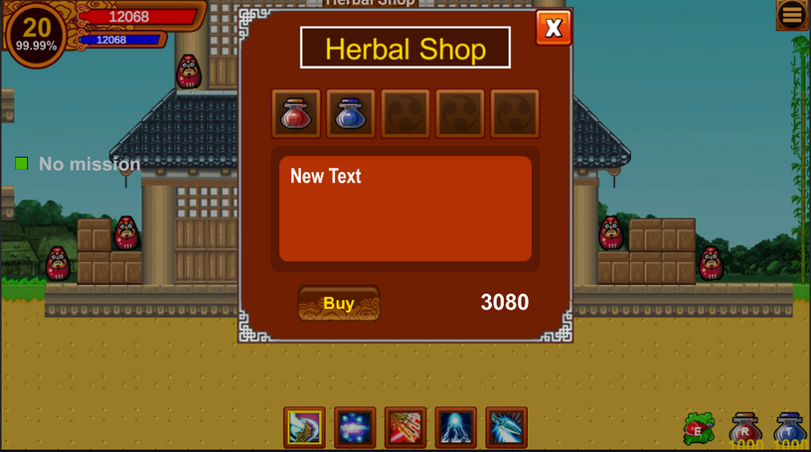
CHAPTER II. USER INTERFACE DESIGN
2.2 Interface design
Function to buy items
Buy herbal item
15
16
Notes:
Monday, June 24, 2024
15

Slide 19
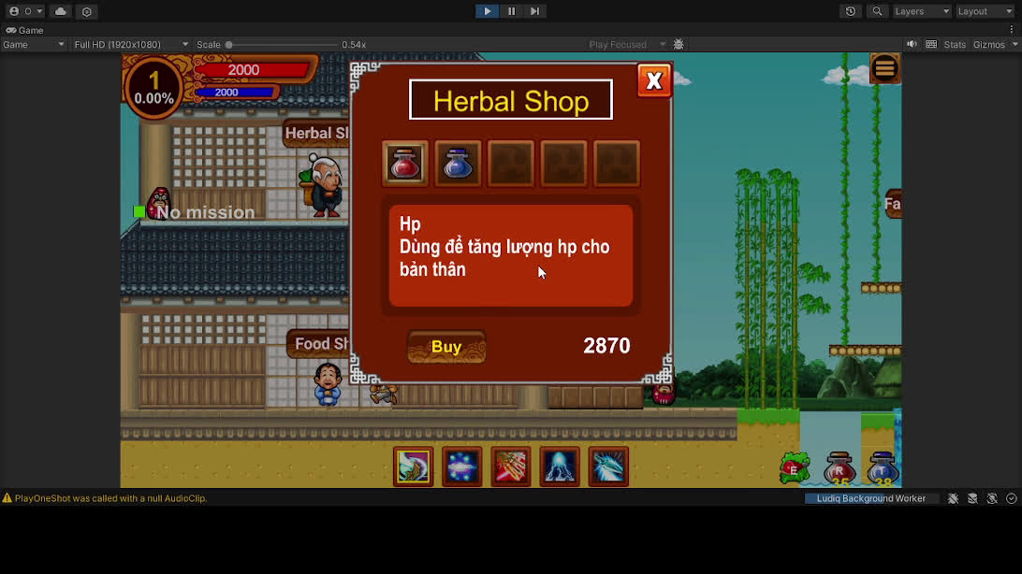
CHAPTER II. USER INTERFACE DESIGN
2.2 Interface design
Function to buy items
15
17

Slide 20
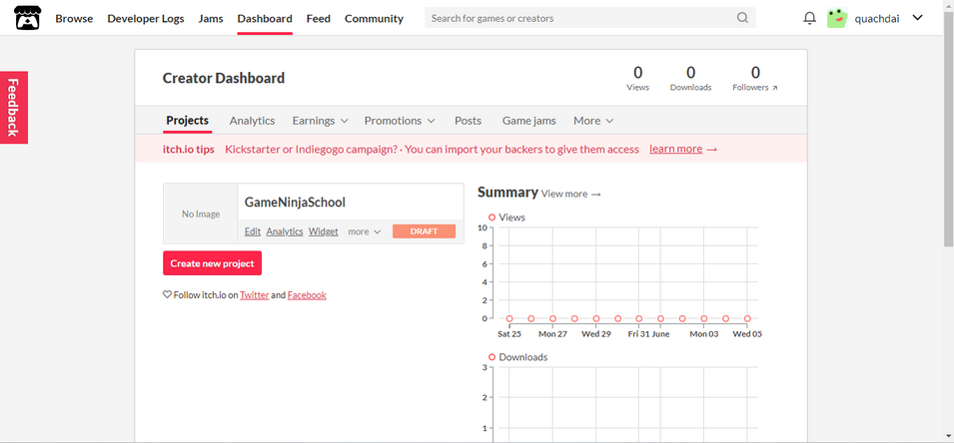
CHAPTER II. USER INTERFACE DESIGN
2.3 Instructions for playing games on the website
Step 1. https://quachdai.itch.io/gameninjaschool
16
18
Notes:
Monday, June 24, 2024
16

Slide 21
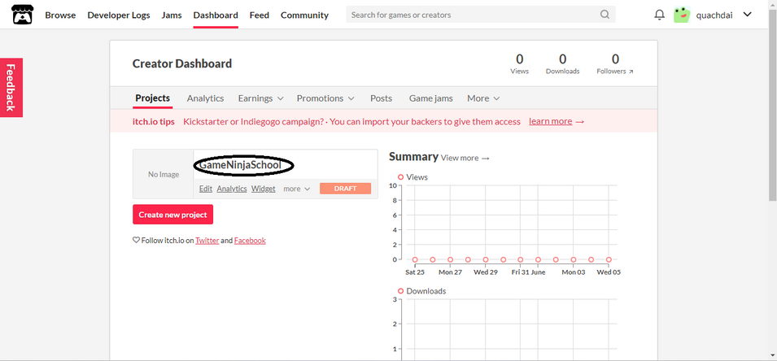
CHAPTER II. USER INTERFACE DESIGN
2.3 Instructions for playing games on the website
Step2. Click gameNinjaSchool
17
19
Notes:
Monday, June 24, 2024
17

Slide 22

CHAPTER II. USER INTERFACE DESIGN
2.3 Instructions for playing games on the website
Step 3 Click Run game
18
20
Notes:
Monday, June 24, 2024
18

Slide 23
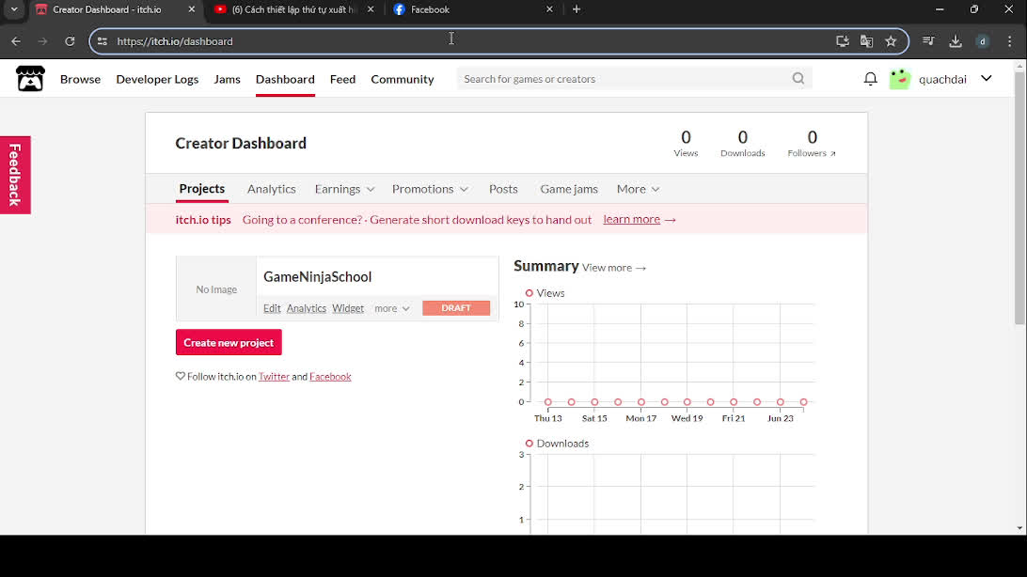
CHAPTER II. USER INTERFACE DESIGN
2.3 Instructions for playing games on the website
Step 3 Click Run game
18
21

Slide 24
CONCLUSION
During the project implementation, I encountered many different challenges due to having to delve into unfamiliar areas. However, with the enthusiastic support of my advisor and myself, I completed the project on time and achieved quite good results.
* Personal skills.
- Apply the knowledge and skills that I have been trained in 4 years of studying at the University of Transport and Communications .
- Improve game programming ability, using Unity Engine,
19
22
Notes:
Monday, June 24, 2024
19

Slide 25
CONCLUSION
Positive of the product
- Successfully built games on the Windows platform
- The product has been publicly posted on the website https://itch.io/dashboard.
- Successfully built some main functions: Missions, buying and selling items, controlling characters, etc.
Negatives of the product
- The artificial intelligence component of the monster is still simple.
- The map is still simple.
- Only run games on Windows platforms.
Development direction
- Improved the map to make it more beautiful and added many new maps.
- Expanded many new functions: equipment can be upgraded, pets can assist in attacking monsters.
- The game can run on Android, iOS, etc.
20
23
Notes:
Monday, June 24, 2024
20

Slide 26
Thank you very much
for your kind attention!
21
Notes:
Monday, June 24, 2024
21

Slide 27
***Outline***
I
OVERVIEW
4
II
USER INTERFACE DESIGN
11
III
CONCLUSION
12
IV
Contribution & limitation
29
V
Conclusion & Future work
31
22

